Slide 1

SARCASM DETECTION
By Vaibhav Chandra (B.Tech Student, CSE, IIT Indore)
Supervisor: Dr. Nagendra Kumar

Slide 2
PROBLEM STATEMENT
This project aims to develop a complete deep learning pipeline for the task of sarcasm detection
Sarcasm detection basically involves classifying a given corpus of text as either sarcastic or non-sarcastic
The corpus of text maybe a tweet, news headline, facebook comments or other sources
Various pre-trained Deep learning architectures have been assessed for this task
<number>

Slide 3
INTRODUCTION
The field of Natural Language Processing (NLP) has been successfully used in a wide range of tasks such as classification, text summarization, translation, part of speech tagging and others
With the recent advancement in the architectures used in NLP, researchers have been trying to tackle many real life scenarios
Sarcasm Detection is one such problem that has grabbed the attention of researchers
Many new architectures have been developed for solving this task of sarcasm detection. Most of these architectures revolve around the Transformer⁽¹⁾ model
We provide a comprehensive comparison of different transformer models that are well suited for this classification problem
<number>
(1): Vaswani, Ashish, et al. "Attention is all you need." Advances in neural information processing systems 30 (2017).

Slide 4
TRANSFORMERS
Transformer was proposed by a group of Google Researchers
It uses Multi-head Self-Attention mechanism to capture long range dependencies in the text
It is due to this attention mechanism that the transformer model has been successfully proposed in almost every domain that stems from NLP
Transformers improve upon its traditional counterpart LSTM by parallelisation of inputs
<number>

Slide 5
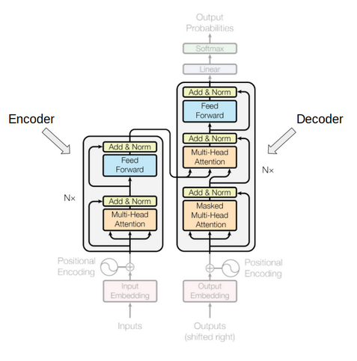
TRANSFORMERS
<number>

Slide 6
DEEP LEARNING MODELS
With the advent of Transformer, many deep learning architectures have been proposed that can be used for wide variety of downstream tasks
BERT is one such revolutionary model which stands for Bidirectional Encoder Representations from Transformers
It is designed to pre-train deep bidirectional representations from unlabeled text by jointly conditioning on both left and right context in all layers
It uses “masked language model” (MLM) pre-training that enables it to achieve state-of-the-art metrics for GLUE, MNLI, SQuAD
We compare three models namely RoBERTa,DistilBERT and alBERT that are built upon the BERT model on our problem of sarcasm detection
<number>

Slide 7
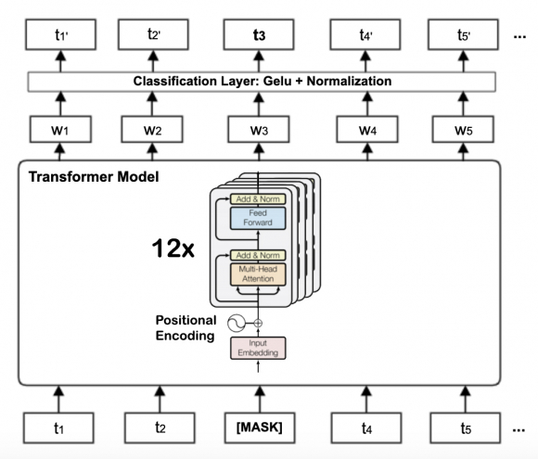
BERT Model
<number>

Slide 8
RoBERTa
BERT was computationally expensive model containing millions of hyperparameters and was highly undertrained
RoBERTa was , hence, developed to cater the shortcomings of the BERT model
Modifications on top of BERT include:
Training the model longer, with bigger batches,over more data
Removing the next sentence prediction objective
Training on longer sequences
Dynamically changing the masking pattern applied to the training data
<number>

Slide 9
DistilBERT
BERT model was very big in size in terms of number of hyperparameters. DistilBERT aimed at reducing this size
DistilBERT was 40% smaller in size and 60% faster than BERT while retaining the language learning capabilities
The novelty introduced in DistilBERT included a triple loss combining:
language modeling
distillation
cosine-distance losses
<number>

Slide 10
alBERT
alBERT was also built upon BERT aiming to reduce memory consumption and increasing training speed
Since alBERT and RoBERTa try to overcome the same problem of high memory consumption and large model size of BERT, they have a number of similarities
alBERT establishes new state-of-the-art results on the GLUE, RACE, and SQuAD benchmarks while having fewer parameters compared to BERT-large
<number>

Slide 11
DATASET
The dataset that we have used to train the discussed models consists a number of news headlines
Each headline has a corresponding labels indicating whether it is a sarcastic or a non-sarcastic headline
The dataset has about ~27000 data points
The same can be accessessed here:- dataset
Description | Size
Total Samples | 26,709
Training Samples | 20,000
Testing Samples | 6,709
<number>

Slide 12
MODELS COMPARISON
We compare the three models discussed previously namely RoBERTa, DistilBERT and alBERT for the sarcasm detection task
Models | Training Accuracy(%) | Testing Accuracy(%)
RoBERTa | 97.47 | 90.49
DistilBERT | 98.73 | 91.14
alBERT | 96.66 | 88.24
<number>

Slide 13
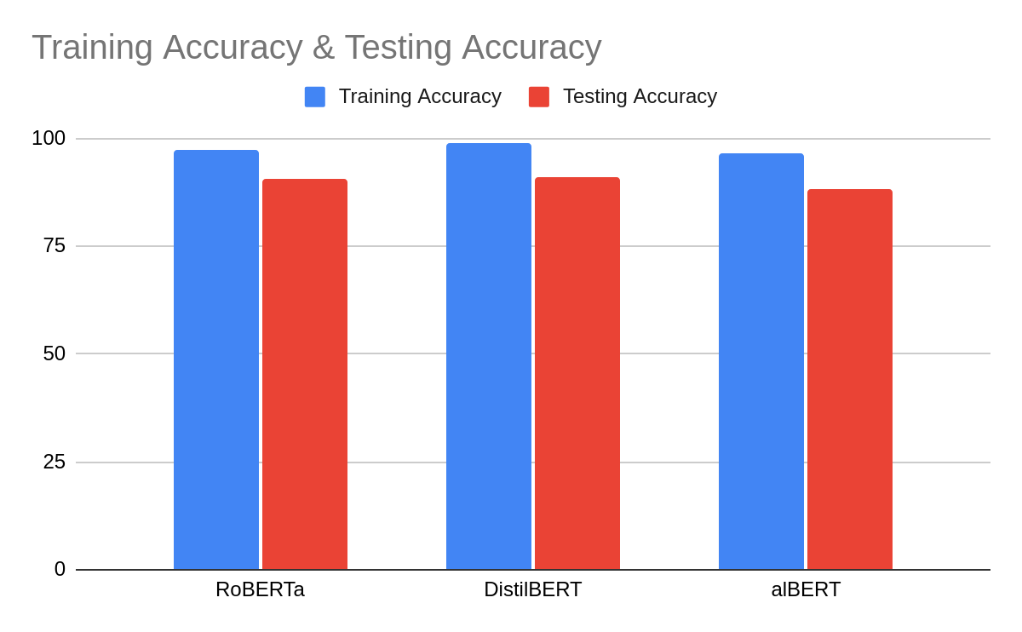
MODELS COMPARISON
The table presented can also be visualized as follows:
<number>

Slide 14
CONCLUSION
We discussed the problem of sarcasm detection which has emerged has a new research topic in the field of NLP
We also discussed transformer-based deep learning models that can be used to solve this task
The metrics obtained shows the effectiveness of these models for this sarcasm detection task
We aim to test few more models and also try to build a novel model in this direction
<number>

